Slide 1
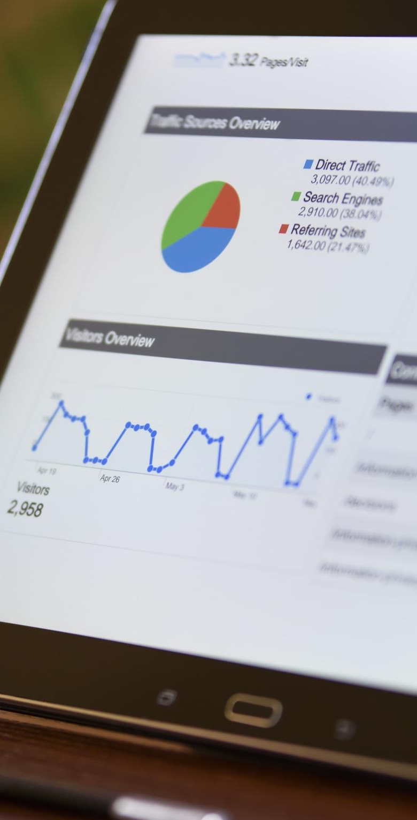

FULLSTACK INTENSIVE BOOTCAMP
Data Analyst
How to Measure Business Performance
Oleh: _ _ _
JOIN THE BEST UPSKILLING COMMUNITY
WITH ME at myskill.id/bootcamp
MINI PORTOFOLIO

Slide 2

Course Summary
Buat rangkuman singkat tentang materi yang baru kamu pelajari di sini, yuk! :)
#RintisKarirImpian

Slide 3
15 MINS: LET’S DO THIS!
Case 1 - Product Evaluation through Product Market Fit
Case 2 - Measure and Evaluate Last Year KPI Performance
Case 3 - Develop your own OKR
Case for I and II https://docs.google.com/spreadsheets/d/1LOptdp-M4ph6ikfQqOayuAIQ3_oJDpb50mFuM9L7WKo/edit#gid=0
#RintisKarirImpian

